Slide 1
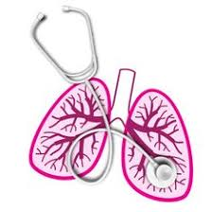
University of Basrah Al-zahraa medical college
Ministry of Higher Education and Scientific Research
Respiratory system module Academic year 2021-2022 2^{ed} year S 4
Session: Lecture:
Chemical control of breathing
Module staff:
Dr. Nehaya Mnahi
[module leader]
Dr. Ahmed Badr
Dr. Nawal Mustafa
Dr. Firas Mohamed
Dr.Ahmed Ibrahim
Dr. Ahmed Jafer
Dr.Karam Basil
Dr. Amer Qasim
Dr. Ahmed Qassim
Dr. Mohamed Adil

Slide 2
University of Basrah Al-zahraa medical college
Ministry of Higher Education and Scientific Research
Learning objective :
Knowing the pathophysiology of asthma
Clinical presentation of asthma
How to diagnose asthma
Classification of asthma severity.
Steps in management of asthma
Review of drugs used in treatment of asthma

Slide 3
University of Basrah Al-zahraa medical college
Ministry of Higher Education and Scientific Research
LO1
We have two major types of air way disease :
Obstructive air way disease which mainly include:
Bronchial asthma .
Chronic obstructive air way disease.
Restrictive air way disease such as ( lung fibrosis , occupation air way disease ..etc).

Slide 4
University of Basrah Al-zahraa medical college
Ministry of Higher Education and Scientific Research
LO1
Bronchial asthma:
Asthma is a chronic inflammatory disorder of the airways, in which many cells and cellular elements play a role.
Chronic inflammation is associated with airway hyper-responsiveness that leads to recurrent episodes of wheezing, breathlessness, chest tightness and coughing, particularly at night and in the early morning.
These episodes are usually associated with widespread but variable airflow obstruction within the lung that is often reversible, either spontaneously or with treatment.

Slide 5
University of Basrah Al-zahraa medical college
Ministry of Higher Education and Scientific Research
Airway hyper-reactivity :the tendency for airways to narrow excessively in response to triggers that have little or no effect in normal individuals – is integral to the diagnosis of asthma and appears to be related.
Common examples of allergens include house dust mites, pets such as cats and dogs, pests such as cockroaches, and fungi. Inhalation of an allergen into the airway is followed by an early and late-phase bronchoconstrictor response.
LO1

Slide 6
University of Basrah Al-zahraa medical college
Ministry of Higher Education and Scientific Research
LO1
the early phase response (EPR) usually involves cells which are normal residents of the respiratory epithelium (mast cells) and pre-formed substances (histamine), whereas cells participating in the late phase reaction (LPR) are arecruited from the circulation (eosinophils, basophils and T cells).
The mediators also induce chemotactic recruitment and activation of eosinophils and neutrophils during the late-phase reaction (LPR). The numbers of eosinophils and neutrophils are increased 4 h after challenge with allergen in the broncho-alveolar lavage fluid (BAL) of asthmatics who show an LPR.

Slide 7
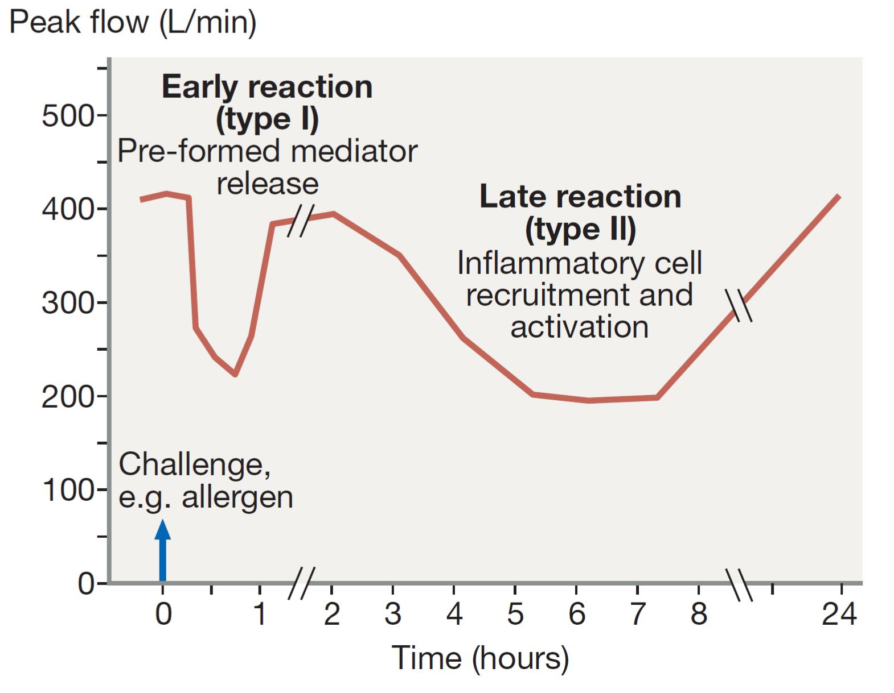
University of Basrah Al-zahraa medical college
Ministry of Higher Education and Scientific Research
LO1

Slide 8
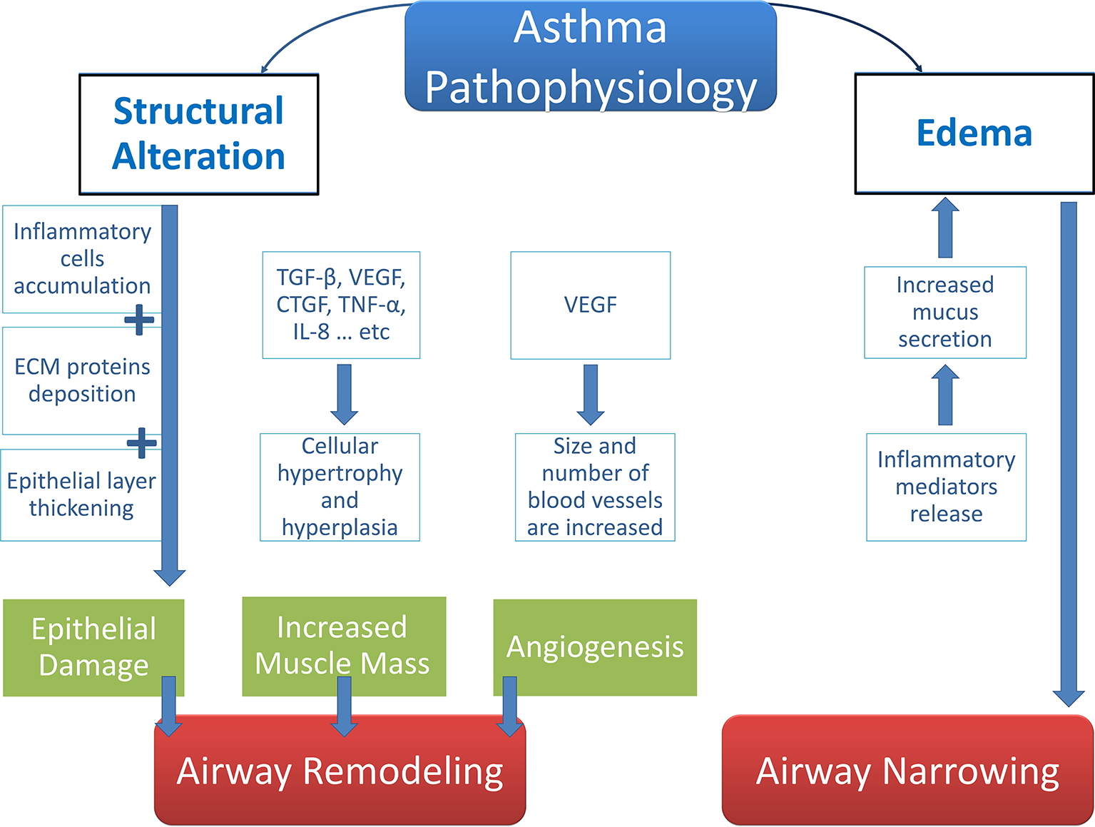
University of Basrah Al-zahraa medical college
Ministry of Higher Education and Scientific Research
LO1

Slide 9
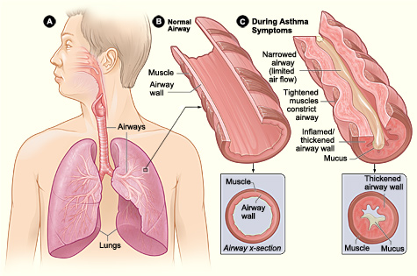
University of Basrah Al-zahraa medical college
Ministry of Higher Education and Scientific Research
LO1

Slide 10
University of Basrah Al-zahraa medical college
Ministry of Higher Education and Scientific Research
Symptoms of asthma:
Cough
Wheeze
Chest tightness
Shortness of breath
Investigations:
Spirometry
LO2

Slide 11
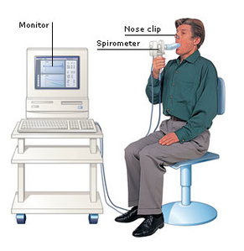
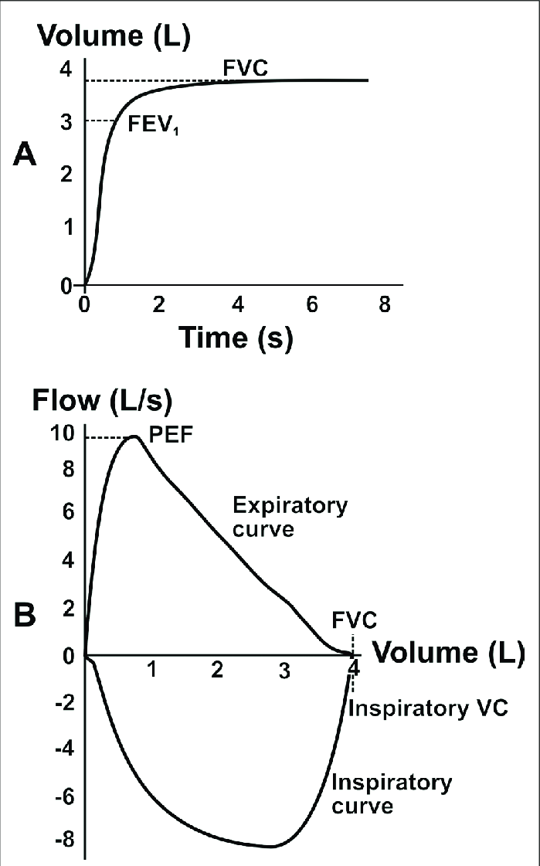
University of Basrah Al-zahraa medical college
Ministry of Higher Education and Scientific Research
LO3

Slide 12
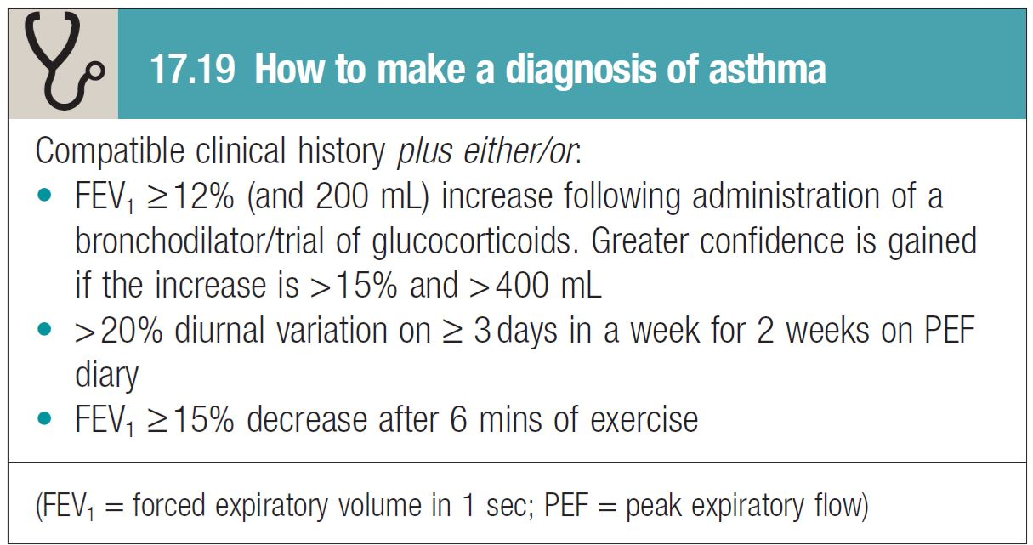
University of Basrah Al-zahraa medical college
Ministry of Higher Education and Scientific Research
LO3
Diagnosis of asthma

Slide 13
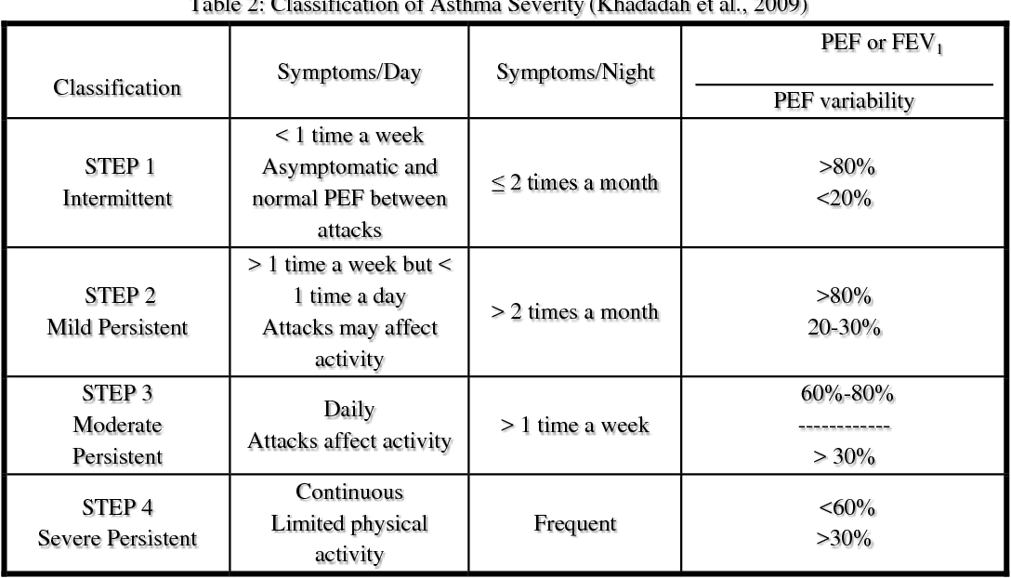
University of Basrah Al-zahraa medical college
Ministry of Higher Education and Scientific Research
Classification of asthma severity
LO4

Slide 14
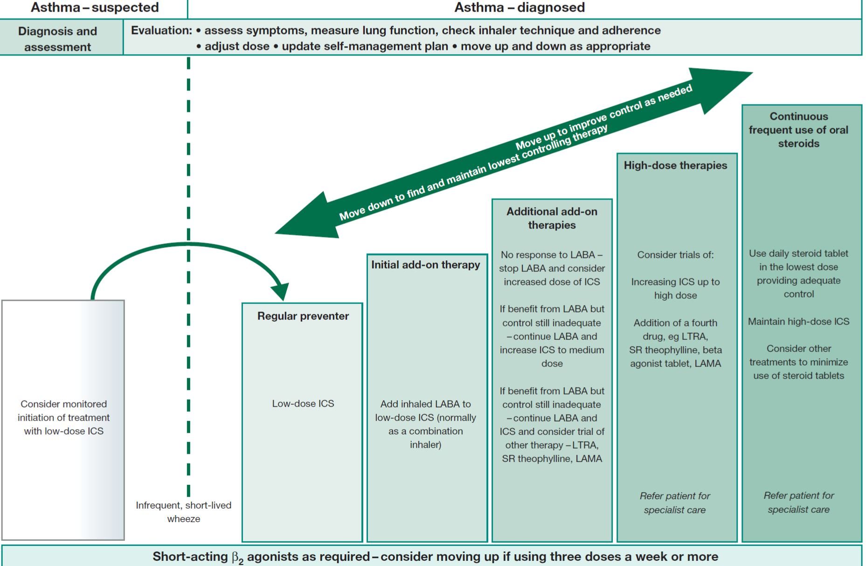
University of Basrah Al-zahraa medical college
Ministry of Higher Education and Scientific Research
Steps in management of asthma
LO5

Slide 15
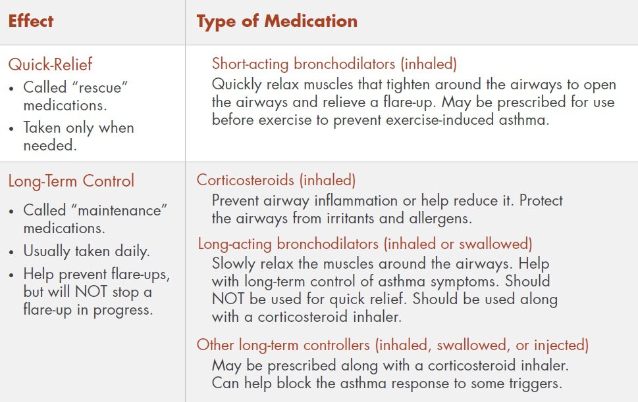
University of Basrah Al-zahraa medical college
Ministry of Higher Education and Scientific Research
Drugs used in treatment of asthma
LO6

Slide 16
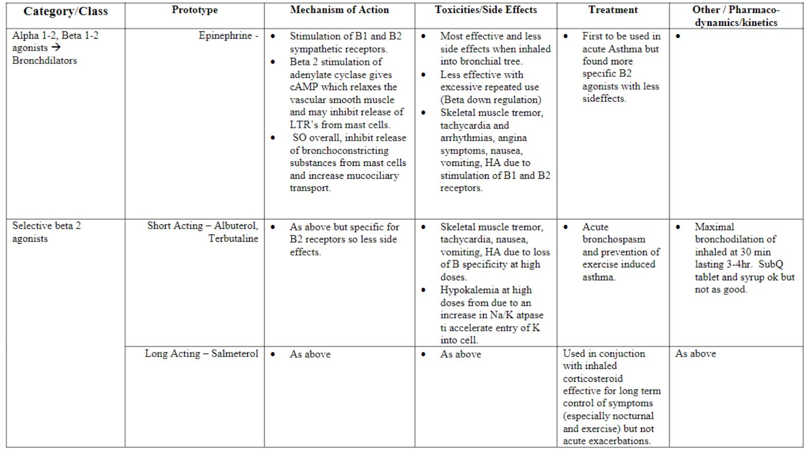
University of Basrah Al-zahraa medical college
Ministry of Higher Education and Scientific Research
Drugs used in treatment of asthma
LO6

Slide 17
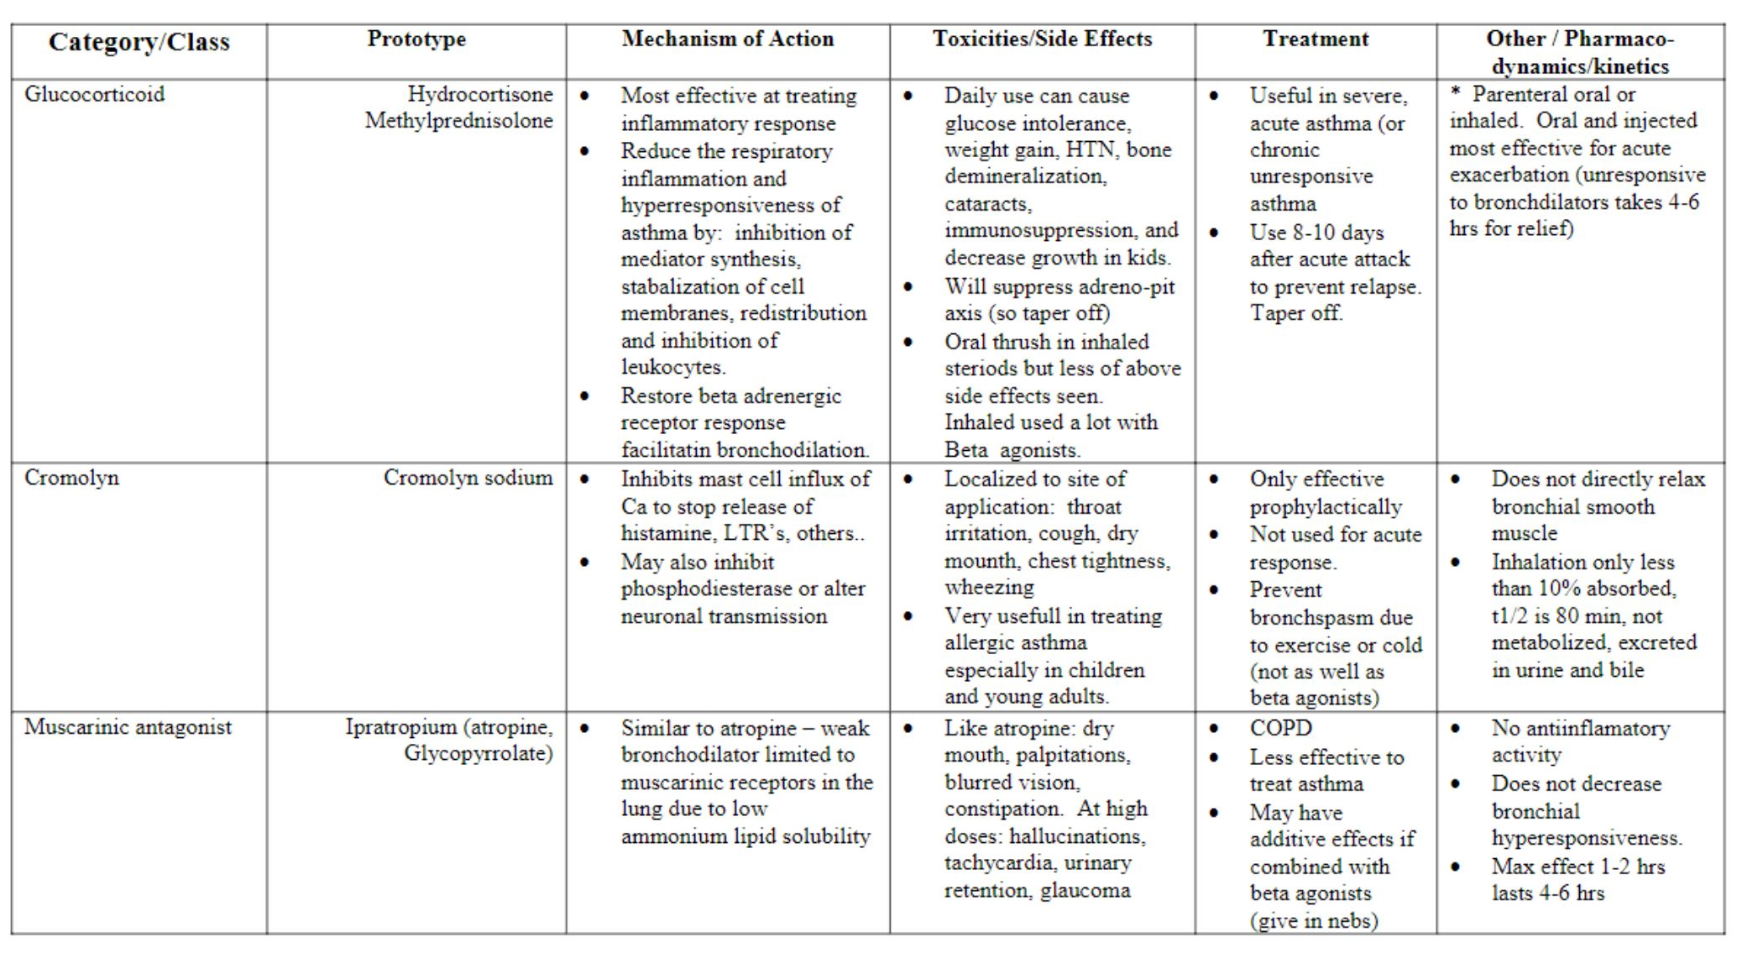
University of Basrah Al-zahraa medical college
Ministry of Higher Education and Scientific Research
LO6
Drugs used in treatment of asthma

Slide 18
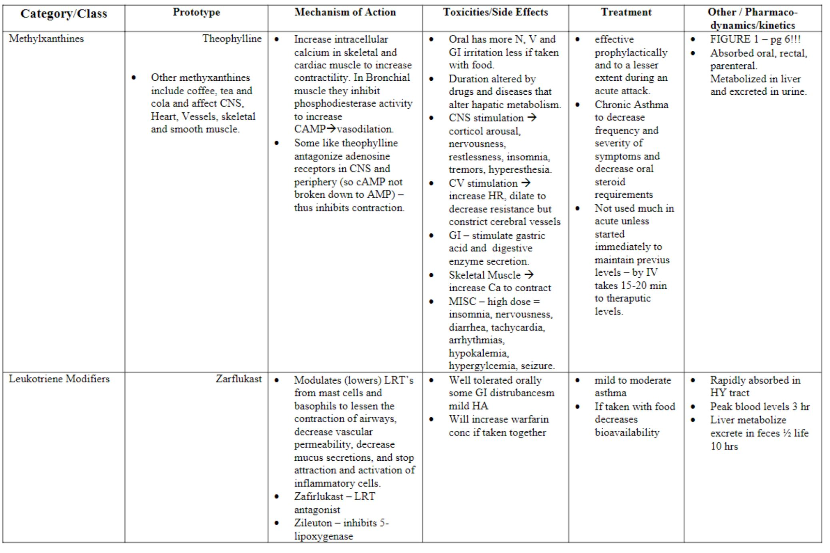
University of Basrah Al-zahraa medical college
Ministry of Higher Education and Scientific Research
LO6
Drugs used in treatment of asthma

Slide 19
University of Basrah Al-zahraa medical college
Ministry of Higher Education and Scientific Research
Thank you

